Slide 1
Clean Architecture
Implementing in .NET
Ian Cooper
@ICooper

Slide 2
Who are you?
Software Developer for more than 20 years
Worked mainly for ISVs
Reuters, SunGard, Misys, Huddle
Worked for a couple of MIS departments
DTI, Beazley
Microsoft MVP for C#
Interested in architecture and design
Interested in Agile methodologies and practices
No smart guys
Just the guys in this room

Slide 3
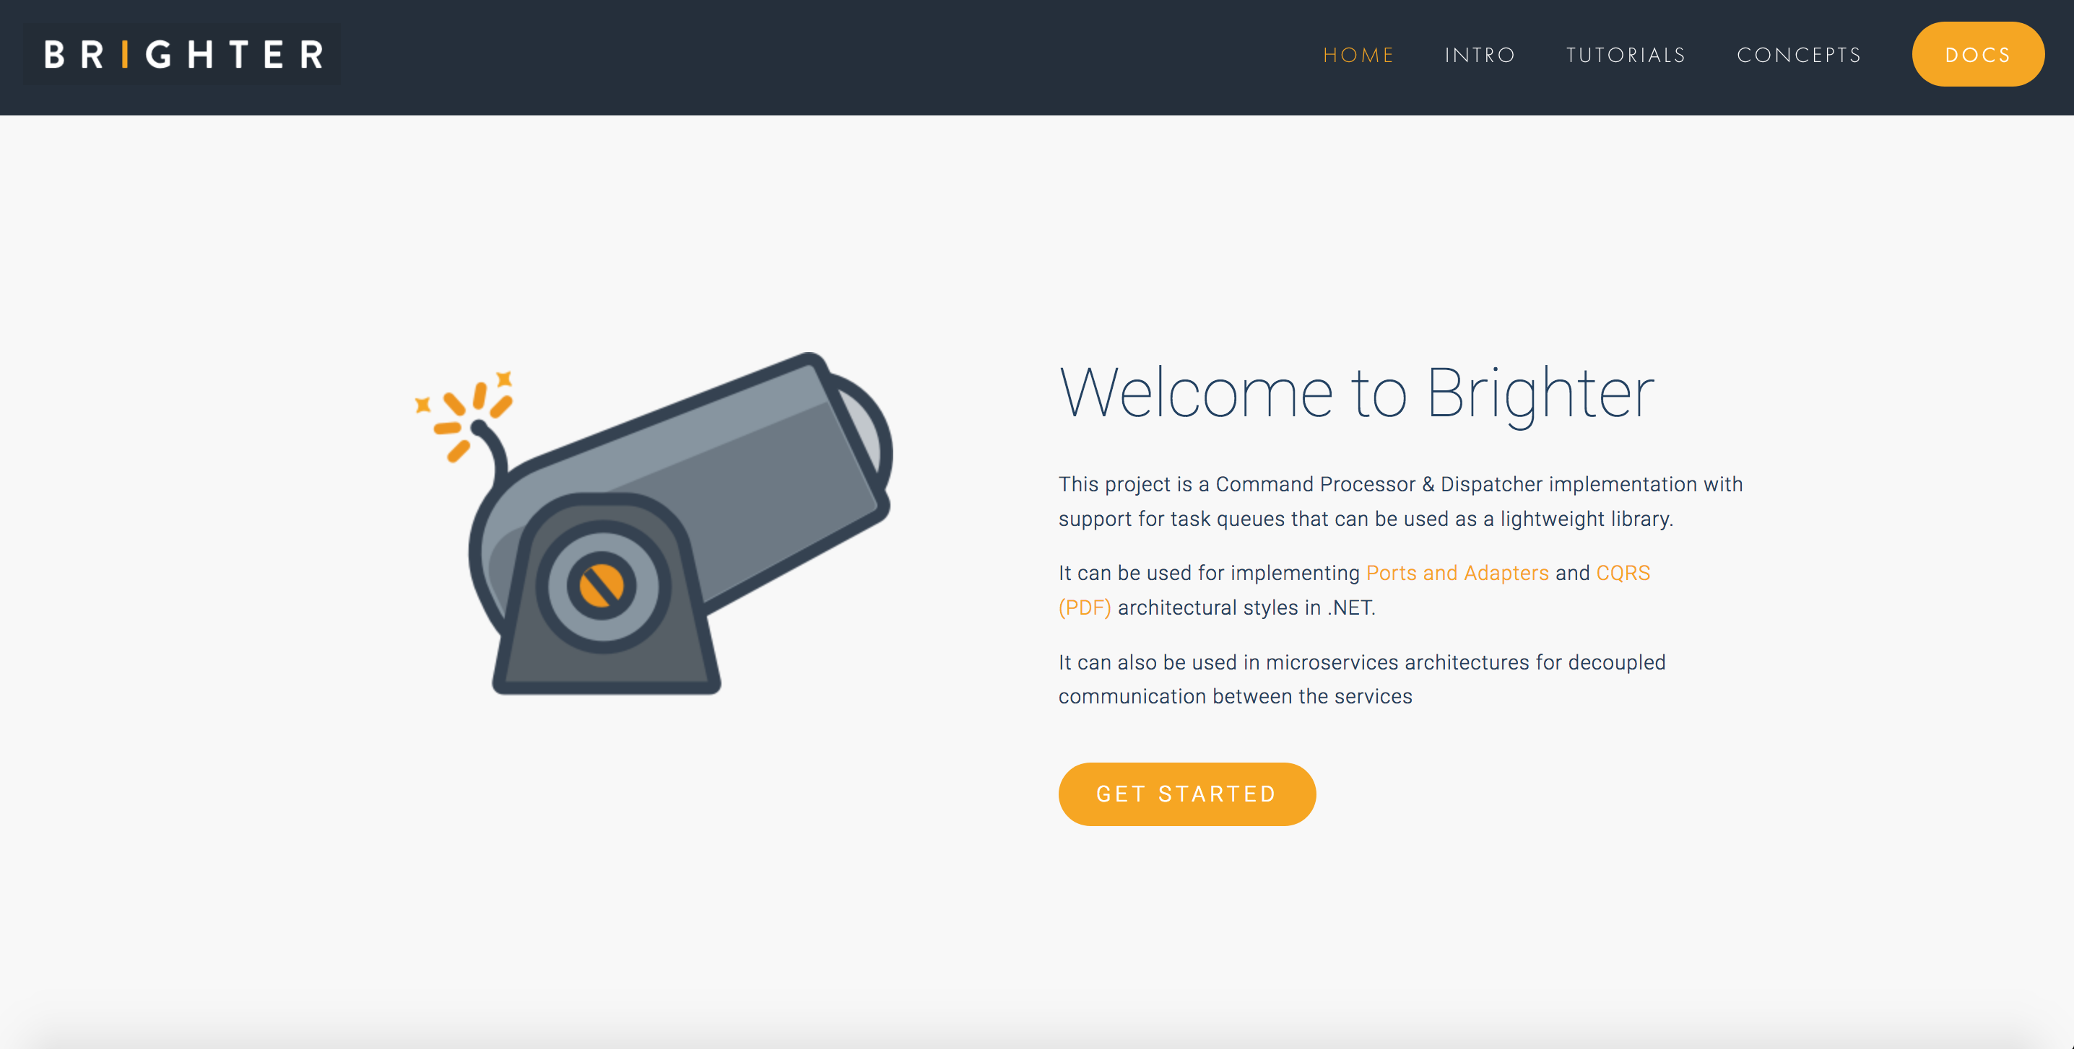

Slide 4
Agenda
On Modules
On Layering
On Domains
On Clean Architecture
On Implementing

Slide 5
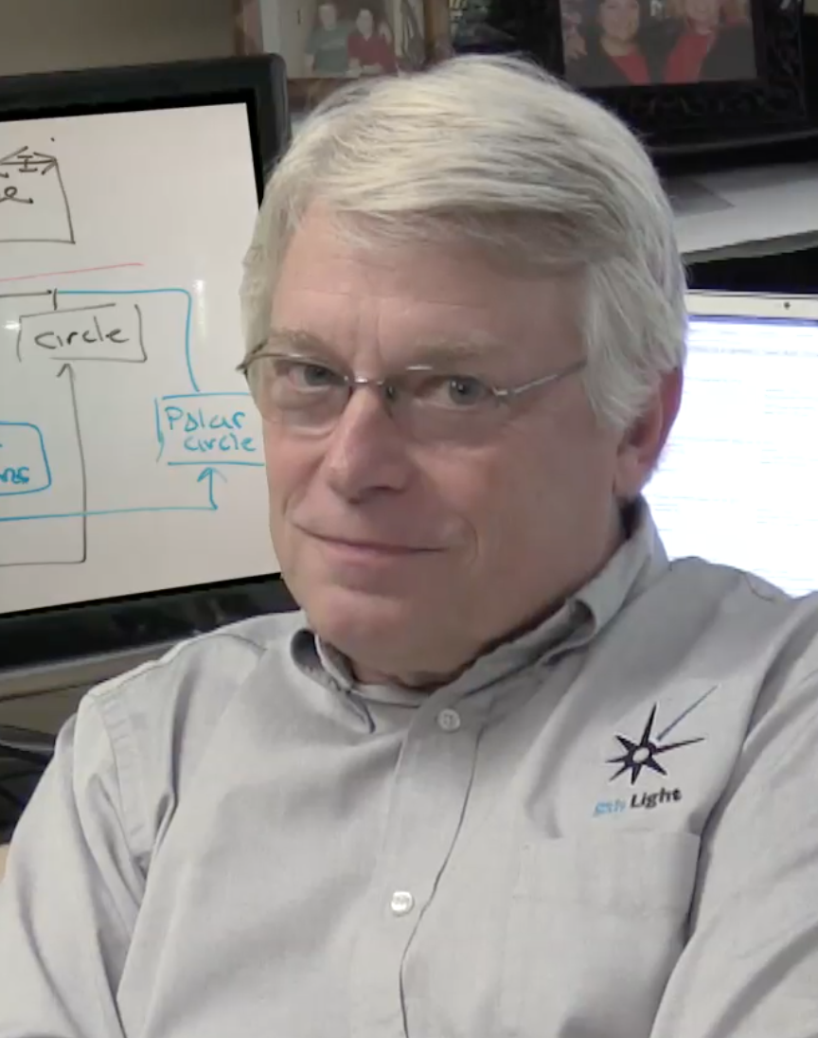




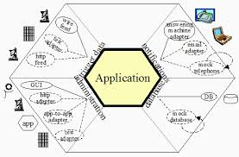
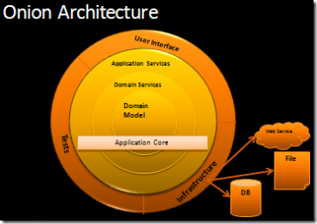
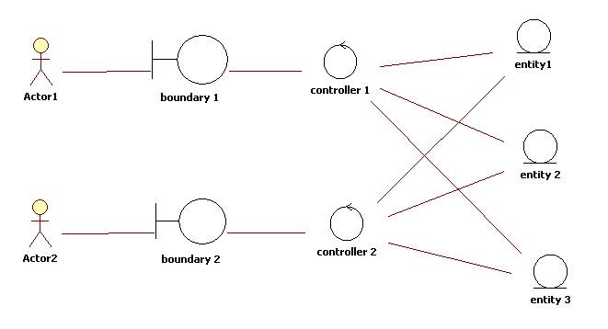
Robert Martin
Jeffrey Palermo
Ivar Jacobson
Alistair Cockburn

Slide 6
On Modules
5

Slide 7


Module
The façade hides details. A coarse grained façade minimizes the surface are depended upon by a client.
Implementation Details
Coarse Grained Facade
A client cannot access implementation details – information hiding principle

Slide 8
Modules
Coarse Grained Facade
Implementation Details
Coarse Grained Facade
Implementation Details
We can slice up a system into multiple modules.
This allows teams to work independently.
It is easier to learn a system, module by module.
It is easier to reason about modules
A module’s details should depend upon another module’s abstractions (façade).
Coarse Grained Facade
Implementation Details
The abstraction (façade) of a module, should not depend on the details of another module.
Coarse Grained Facade
Coarse Grained Facade
Implementation Details
Implementation Details

Slide 9
Cohesion and Coupling
Coarse Grained Facade
Implementation Details
Coarse Grained Facade
Implementation Details
Because we depend upon an abstraction, we minimize the dependencies between code in modules.
We have low coupling
A module is not a step in the flow of the system, instead it hides design details.
Because we hide details about a single responsibility we have high cohesion
Coarse Grained Facade
Implementation Details
Coarse Grained Facade
Coarse Grained Facade
Implementation Details
Implementation Details

Slide 10
High and Low
Coarse Grained Facade
Implementation Details
Coarse Grained Facade
Implementation Details
A high level module has dependencies
Coarse Grained Facade
Implementation Details
Coarse Grained Facade
Coarse Grained Facade
Implementation Details
Implementation Details
A low level module has no dependencies

Slide 11
Interchangeability
Room Booking Module
Implementation Details
Room Booking Module
Implementation Details
If two modules present the same abstraction, in other words have the same contract with a client then we can swap one for another.
This allows us to change implementations, for modifiability or business requirements
Notes:
Teams can work on separate modules with low communication – thus reducing coordination costs and lowering development time and effort
You can change a module’s implementation without changing other modules
You can understand the system one module at a time

Slide 12
Substitution
Coarse Grained Facade
Implementation Details
Coarse Grained Facade
Implementation Details
Because a module implements an abstraction, we can substitute it with a dummy to defer a design decision, whilst working on other modules
We can isolate a module for testing by swapping its dependencies for a stub
Coarse Grained Facade
Implementation Details
Notes:
Teams can work on separate modules with low communication – thus reducing coordination costs and lowering development time and effort
You can change a module’s implementation without changing other modules
You can understand the system one module at a time

Slide 13
Modules in .NET
In .NET a module simply means a compiled file, which is linked into an assembly, but we need a higher level concept for information hiding
Assembly – is .NET’s high level module concept
We can control what we export with access modifiers: public, internal & private
This gives us information hiding
We can reuse by creating a reference from one assembly to another

Slide 14
On Layering
5

Slide 15
1: If I change the façade of A, the implementation details of C which depend on it need to change.
I need to build A, then build C.
Cyclic Dependency
C
2: Now if this caused the interface of C to also change, it would force the implementation details of B to change.
I need to build A, then build C, then build B.
A
Coarse Grained Facade
Implementation Details
Coarse Grained Facade
Implementation Details
Coarse Grained Facade
3: In turn, if this caused the interface of B and thus implementation of A to change
I need to build A, then build C, then build B, then build A, then B.
Implementation Details
B
I have a cyclic dependency
Notes:
If I change the façade of A, the implementation details of C which depend on it need to change.
I need to build A, then build C.
Now if this caused the interface of C to also change, it would force the implementation details of B to change.
I need to build A, then build C, then build B.
In turn, if this caused the implementation of A to change I have a cycil

Slide 16
Layers
A
D
UI
Domain
Relaxed Model Only
B
C
Infrastructure
Notes:
We depend downward with a layered infrastructure to prevent cycles of dependency between modules.
When thinking of a system in terms of layers, you imagine the principal subsystems in the software arranged in some form of layer cake, where each layer rests on a lower layer. In this scheme the higher layer uses various services defined by the lower layer, but the lower layer is unaware of the higher layer. Furthermore, each layer usually hides its lower layers from the layers above, so layer 4 uses the services of layer 3, which uses the services of layer 2, but layer 4 is unaware of layer 2. Fowler, Martin. Patterns of Enterprise Application Architecture (Addison-Wesley Signature Series (Fowler)) (p. 17).
Presentation logic is about how to handle the interaction between the user and the software. This can be as simple as a command-line or text-based menu system, but these days it’s more likely to be a rich-client graphics UI or an HTML-based browser UI. (In this book I use rich client to mean a Windows/Swing/fat-client UI, as opposed to an HTML browser.) The primary responsibilities of the presentation layer are to display information to the user and to interpret commands from the user into actions upon the domain and data source.
Data source logic is about communicating with other systems that carry out tasks on behalf of the application. These can be transaction monitors, other applications, messaging systems, and so forth. For most enterprise applications the biggest piece of data source logic is a database that is primarily responsible for storing persistent data.
The remaining piece is the domain logic, also referred to as business logic. This is the work that this application needs to do for the domain you’re working with. It involves calculations based on inputs and stored data, validation of any data that comes in from the presentation, and figuring out exactly what data source logic to dispatch, depending on commands received from the presentation.

Slide 17
Dependency Inversion
A
D
Implements Interface
UI
Creates D
Passes to B
Domain
B
Interface D
Exposes Requirements as Interface
C
Infrastructure

Slide 18
On Domains
20

Slide 19
We can distinguish two types of ‘business logic’
Domain logic, having to do purely with the domain, such as calculating an insurance premium, or figuring out the shortest path to ship a package.
Application logic, having to do with application responsibilities, often referred to as workflow logic

Slide 20
A
UI
B
Service
Domain
Entity
C
D
Infrastructure
Notes:
A common approach in handling domain logic is to split the domain layer in two.
A Service Layer is placed over an underlying Entity Model.
Usually you only get this with a Domain Model (since a domain layer that uses only Transaction Script isn’t complex enough to warrant a separate layer. The presentation logic interacts with the domain purely through the Service Layer, which acts as an API for the application.
The Service Layer represent application logic. It is most commonly associated with co-ordination and control logic for the domain, and calls to the Infrastructure layer to ‘load’ the domain.
As well as providing a clear API, the Service Layer (133) is also a good spot to place such things as transaction control and security. This gives you a simple model of taking each method in the Service Layer (133) and describing its transactional and security characteristics. A separate properties file is a common choice for this, but .NET’s attributes provide a nice way of doing it directly in the code.
When you see a Service Layer (133), a key decision is how much behavior to put in it. The minimal case is to make the Service Layer (133) a facade so that all of the real behavior is in underlying objects and all the Service Layer (133) does is forward calls on the facade to lower-level objects. In that case the Service Layer (133) provides an API that’s easier to use because it’s typically oriented around use cases. It also makes a convenient point for adding transactional wrappers and security checks. At the other extreme, most business logic is placed in Transaction Scripts (110) inside the Service Layer (133). The underlying domain objects are very simple; if it’s a Domain Model (116) it will be one-to-one with the database and you can thus use a simpler data source layer such as Active Record (160).Fowler, Martin. Patterns of Enterprise Application Architecture (Addison-Wesley Signature Series (Fowler)) (p. 31). Pearson Education. Kindle Edition.
As well as providing an API, the Service Layer is also the place where we can put transaction control and security.

Slide 21
There are two basic implementation variations

Slide 22
In the domain facade approach a Service Layer is implemented as a set of thin facades over a Domain Model, exhibiting the defining characteristics of Service Layer.
The classes implementing the facades don’t implement any business logic. The Domain Model implements all of the business logic.
The thin facades establish a boundary and set of operations through which client layers interact with the application

Slide 23
In the operation script approach a Service Layer is implemented as a set of thicker classes that directly implement application logic domain object classes are mainly dumb objects holding state.
The operations available to clients of a Service Layer are implemented as scripts, organized several to a class defining a subject area of related logic.
Each such class forms an application “service,” and it’s common for service type names to end with “Service.”

Slide 24
Ports and Adapters
A ports & adapters architectural style (Hexagonal Architecture) is a variation of the layered architectural style which makes clear the separation between the:
application - which contains the rules of our application
adapters, which abstract the inputs to the application and our outputs
ports, which are ‘purposeful conversations’ between the actor, via the adapter, and the domain model
Notes:
The advantage of this style is that the application is decoupled from the nature of the input or output device, and any frameworks used to implement them.

Slide 25
Application
Adapter
Port
Notes:
Removing any left-right or up-down asymmetry for a moment, we see that the application communicates over ‘’ports’’ to external agencies. The word “port” is supposed to evoke thoughts of ‘’ports’’ in an operating system, where any device that adheres to the protocols of a port can be plugged into it; and ‘’ports’’ on electronics gadgets, where again, any device that fits the mechanical and electrical protocols can be plugged in.
The protocol for a port is given by the purpose of the conversation between the two devices.
The protocol takes the form of an application program interface (API).
For each external device there is an ‘’adapter’’ that converts the API definition to the signals needed by that device and vice versa. A graphical user interface or GUI is an example of an adapter that maps the movements of a person to the API of the port. Other adapters that fit the same port are automated test harnesses such as FIT or Fitnesse, batch drivers, and any code needed for communication between applications across the enterprise or net.
For example when a client POSTs a request to the REST API exposed by our application the adapter receives the HTTP request, transforms it into a call onto our domain, and marshals the response back out to the client over HTTP. Similarly if our application needs to retrieve persisted entity state to initialise the domain it calls out to an adapter that wraps access to the DB.
The layer between the adapter and the domain is identified as the ports layer. Our domain is inside the port, adapters for external entities are on the outside of the port.
The notion of a 'port' invokes the OS idea that any device that adheres to a know protocol can be plugged into a port. Similarly, many adapters may use our ports.

Slide 26
E
Infrastructure
A
Adapter
UI
B
D
<<interface>>
Port
Domain
Dependency Inversion
Application
C
Notes:
The main change is that because our rules say that we must depend inwards, the domain code no longer depends on the infrastructure code. The infrastructure code, called the adapter in this mode depends on the ports or application, but not the other way around. So how do we access the infrastructure i.e. the database from the port or application?
We have to use Dependency inversion. Dependency Inversion is a technique where we reverse the direction of a dependency by introducing an abstraction. We introduce the abstraction of an interface in our layer, which we can depend on, and then the layer that depends on us, provides a concrete implementation of that interface.
At runtime the ‘main’ in our application serves as the Composition Root and hooks us up to that interface.
Note that our port tends to deal with the adapter i.e. If I want to call the database, the port, which holds the application logic does that. It then holds the abstraction of the adapter. The domain is only ever called, it does not call out to the adapter layer, so the port that receives the request from the adapter on the left hand side, orchestrates calls to the adapters on the right hand side.

Slide 27
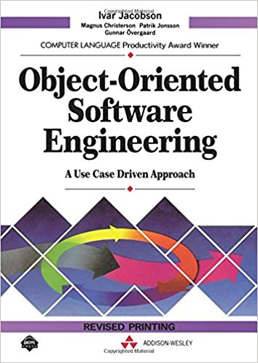
Ivar Jacobson

Slide 28
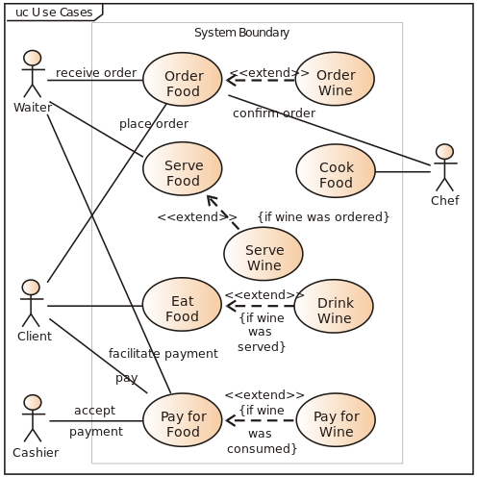
Notes:
In software and systems engineering, a use case is a list of actions or event steps typically defining the interactions between a role (known in the Unified Modeling Language as an actor) and a system to achieve a goal. The actor can be a human or other external system. In systems engineering use cases are used at a higher level than within software engineering often representing missions or stakeholder goals. The detailed requirements may then be captured in the Systems Modeling Language (SysML) or as contractual statements.
Use case analysis is an important and valuable requirement analysis technique that has been widely used in modern software engineering since its formal introduction by Ivar Jacobson in 1992. Use case driven development is a key characteristic of many process models and frameworks such as ICONIX, the Unified Process (UP), the IBM Rational Unified Process (RUP), and the Oracle Unified Method (OUM). With its inherent iterative, incremental and evolutionary nature, use case also fits well for agile development.

Slide 29
Boundary-Controller-Entity
Notes:
Boundary-Controller-Entity is a pattern identified by Ivar Jaobson in his book for building software oriented around use cases
Object Oriented Software Engineering: A Use-Case Driven Approach

Slide 30
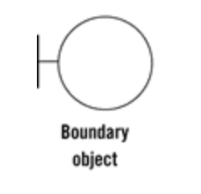
Boundary
The Boundary is an object that interfaces with system actors: user interfaces, gateways, proxies etc.
Notes:
The Boundary is an object that interfaces with system actors: user interfaces, gateways, proxies etc.
Boundary (Interface)
The Boundary objects model the interface with the system.
[…] everything concerning the interface of the system is placed in an interface object
Ivar Jacobson 1992, pp. 134
All functionality dependent on the system environment (tools and delivery mechanisms) belongs in the Boundary objects.
Any interaction of the system with an actor goes through a Boundary object. As Jacobson describes, an actor can be a human user like a customer or an administrator (operator), but it might also be a non-human “user” like an alarm, a printer, or a third party API.

Slide 31
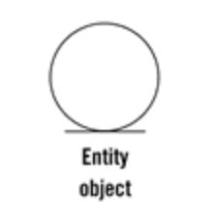
Entity
Entities are objects representing system data: Customer, Transaction, Cart, etc.
Notes:
Entity
The Entity objects hold the data used by the system and all the behavior naturally coupled to this data. Each Entity object represents a concept relevant to the problem domain and which holds identity and resilient (persistent) data. Jacobson tells us that an Entity object should contain the logic that would change when the Entity itself changes, ie. if the data structure it holds changes, the operations on that data will also need to change and therefore they should be located in the Entity as well.
It is interesting to note a warning that Jacobson makes, already back in 1992:
Beginners may sometime only use entity object as data carriers and place all dynamic behavior in control objects […]. This should, however be avoided. […] Instead, quite a lot of behavior should be placed in the entity objects.
They contain application independent business rules i.e. the rules are not dependent on the application it is running in.

Slide 32
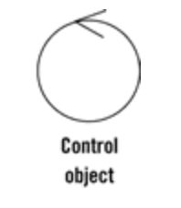
Controller (Interactor)
Controllers are objects that mediate between boundaries and entities. They orchestrate the execution of commands coming from the boundary.
Notes:
Interactor (Control)
The Interactor objects will hold behaviour not naturally tied to any of the other types of objects.
Sutch behaviour consists typically of operations over several Entities, culminating in returning some result to a boundary object.
Behaviour that remains after the Interface objects and Entity objects have obtained their parts will be placed in the control objects
Ivar Jacobson 1992, pp. 185
This means that all behaviour that does not fit into a boundary or Entity will be placed in one or several control objects.
Therefore, Jacobson thinks of Control objects not only as the objects that orchestrate a use case but also as any object that has behaviour relevant for a use case but is not a Boundary nor an Entity.
Comparing with my experience, I would say that he calls interactors to what I call Application Services (who orchestrate use cases) and Domain Services (who contain Domain behaviour but are not entities).
The reason why this intermediary Interactor objects are very important is that if we don’t use them, we will put their specific use case logic in the Entities. However, Entities are used in several use cases and they have, therefore, generic usage. By putting specific use case logic in an Entity, we make it available in several Boundaries, who might end up using it as if it was a generic logic and we might end up changing it to adjust it to another Boundary, increasing its complexity and the chance of breaking the other use cases where it is used.

Slide 33
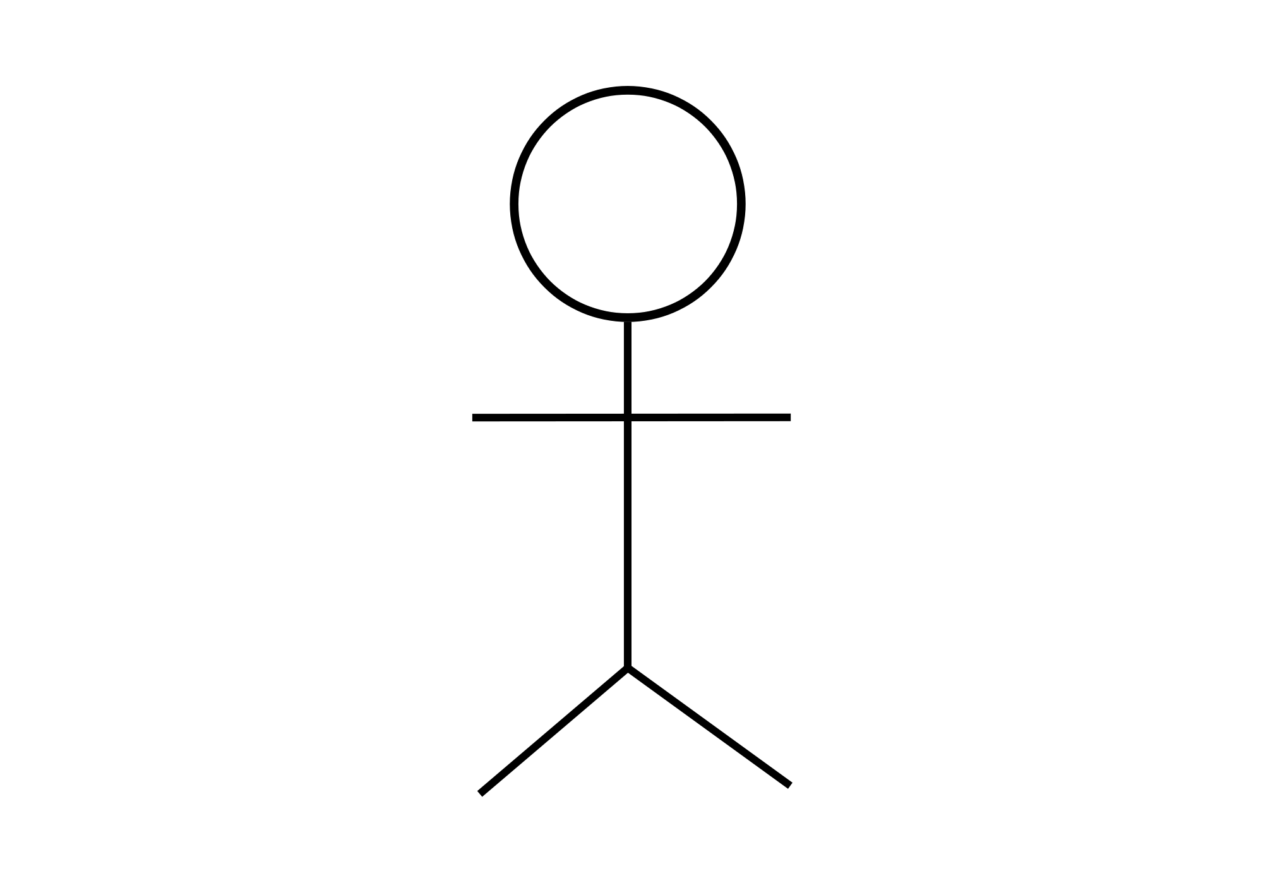

Slide 34
E
Infrastructure
A
Adapter
UI
B
<<interface>>
D
Port
Domain
Application
C

Slide 35
Controllers (Interactors) are objects that implement use cases. There is an interactor for every use case. Name them after the use case. It executes the use case by talking to entities and boundaries. All the interactors together contain your application specific business logic or rules.
A port is the 'use case boundary'. Use cases become problematic when they become focused on technology concerns. Use cases written against the ports can elide those concerns and focus on the application rules, making them easier to write and maintain.

Slide 37
There is a correlation here between the use case boundary and the test boundary - tests should focus on the behaviour expressed by a use case, not on a unit of code.

Slide 38
Notes:
Unit tests exercise individual objects or value types or small clusters of objects within in a single process. In particular, when doing Test-Driven Development, unit tests exercise code that we can change in response to the feedback we get from writing the tests.
Acceptance tests are customer-facing tests that capture the domain logic the system must perform and demonstrates that it performs them.
The Ports & Adapters architecture makes it possible to run acceptance-tests directly against the application domain model because the domain model is cleanly decoupled from the technical infrastructure that connects it to the outside world. Acceptance tests can interact with the domain model through its port interfaces. Acceptance tests written against an isolated domain model can run extremely fast. Because there is no persistent state involved, in databases or message queues for example, it is easy to isolate tests from one another.
Acceptance tests of a distributed system can instantiate the domain models of different processes in the same memory space and link them by implementations of their port interfaces that do not go out-of-process.

Slide 39
Notes:
The term "integration test" can apply to many different kinds of test. In the book, we use the term specifically to mean the test of an abstraction that we own but have implemented with some third-party package. We want to test that our code implementing the abstraction integrates with that third-party package correctly: that we have not made any incorrect assumptions about how it works or tripped over any bugs that we will have to work around. However, we cannot respond to feedback the tests give us about the internal quality of that third-party package because we cannot change it.

Slide 41
On Clean Architecture
30

Slide 42
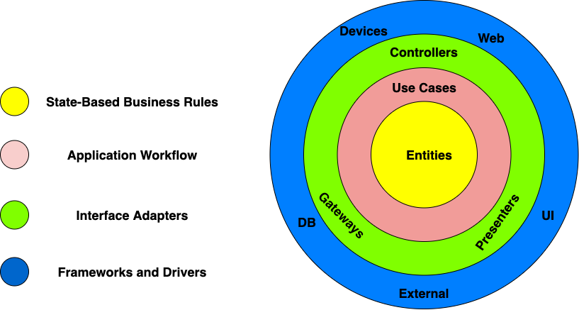

Slide 43
Depend
Inwards
Dependency
Inversion

Slide 44
Request Model
Entity
Entity
Interactor
<<interface>>
Entity
Delivery Mechanism
Boundary
Entity
Use Cases
Response Model
Entity Gateway
<<interface>>
Data Structure
Frameworks & Drivers
Interface Adapters
Notes:
The Request Model is a pure data structure, it has no behavior. It comes through the boundary and it reaches the Interactor, that is named not Interactor, but for the use case. The Interactor goes and finds the Entities, calls the appropriate methods, and then gathers the Response Model from the data.
It sounds like HTTP Request-Response, but there is no HTTP.
To Test: Create the Interactor, Create The Request Model, Run the Interactor and check the Response Model.
You have no dependency on the delivery mechanism. In fact the delivery mechanism depends on you, the application controller, which is your plugin into the framework and implements an interface

Slide 45
Request Model
Entity
Entity
Interactor
<<interface>>
Entity
API Framework
Web Controller
Entity
Use Cases
Presenter
<<interface>>
Response Model
Response Model
Entity Gateway
<<interface>>
Data Structure
Frameworks & Drivers
ViewModel
<<interface>>
Interface Adapters
View
Notes:
A user talks to a delivery mechanism, in this case an API. Eventually a controller gets invoked, with a request model that it then passes to the interactor. The interactor then loads the entities, exercises their business rules, invoked its own business rules, and collates the result into a response model which it passes back, via the web controller to the API framework which serializes it out the user
Note that the Web Controller is a Presenter, and it works with a View Model, that it turns into a view.

Slide 46
Request Model
Entity
Entity
Interactor
<<interface>>
Entity
API
Framework
Web Controller
Entity
Use Cases
Response Model
Entity Gateway
<<interface>>
Data Structure
Frameworks & Drivers
Delivery Mechanism
Interface Adapters
DB
Notes:
How do we talk to the Db. We implement the interface with a concrete boundary component that talks to the DB

Slide 47
On Implementing
Port, Boundary, Interactor, call it what you will but how do we do it?
40

Slide 48
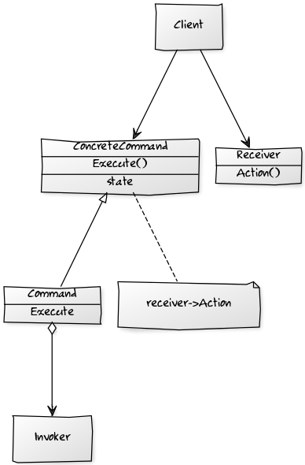
Command Design Pattern
Command - Declares an interface for executing an operation.
ConcreteCommand –Defines a binding between a Receiver object and an action. Implements Execute by invoking the corresponding operation(s) on Receiver.
Client – creates a ConcreteCommand object and sets its receiver.
Invoker - asks the command to carry out the request.
Notes:
The command design pattern encapsulates a request as an object, allowing reuse, queuing or logging of requests, or undoable operations.
It also serves to decouple the implementation of the request from the requestor. The caller of a command object does not need to understand how the command is actioned, only that the command exists. When the caller and the implementer are decoupled it becomes easy to replace or refactor the implementation of the request, without impacting the caller - our system is more modifiable. Our ability to test the command in isolation of the caller - allows us to implement the ports and adapters model easily - we can instantiate the command, provide 'fake' parameters to it and confirm the results. We can also use the command from multiple callers, although this is not a differentiator from the service class approach.

Slide 49
Request Model
Command
Entity
Entity
ICommand
<<interface>>
Entity
Delivery Mechanism
Boundary
Entity
Use Cases
Response Model
Entity Gateway
<<interface>>
Data Structure
Frameworks & Drivers
Interface Adapters
Notes:
The Request Model is a pure data structure, it has no behavior. It comes through the boundary and it reaches the Interactor, that is named not Interactor, but for the use case. The Interactor goes and finds the Entities, calls the appropriate methods, and then gathers the Response Model from the data.
It sounds like HTTP Request-Response, but there is no HTTP.
To Test: Create the Interactor, Create The Request Model, Run the Interactor and check the Response Model.
You have no dependency on the delivery mechanism. In fact the delivery mechanism depends on you, the application controller, which is your plugin into the framework and implements an interface

Slide 50
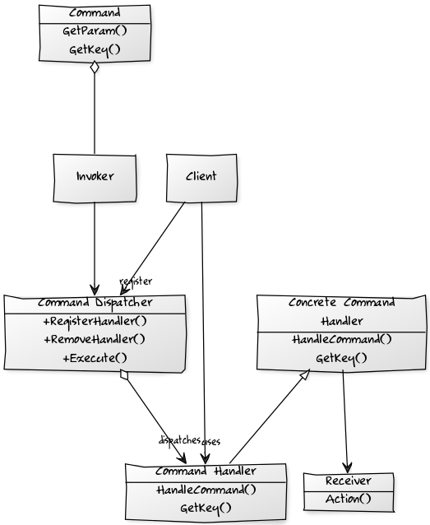
Command Dispatcher
Invoker - has a lit of Commands that are to be executed
Command - represents the request to be processed, encapsulating the parameters to be passed to the command-handler to perform the request
Command Handler - specifies the interface that any command handler must implement
Concrete Command Handler – implements the request
Command Dispatcher – Allows dynamic registration of Command Handlers and looks up handlers for commands, by matching command and handler key.
Client – registers Commands with the Command Dispatcher.
Notes:
To decouple a higher and lower layers we want to be able alter the implementation of the commands that we call on the lower layer without altering the calling layer.
We introduce a Command Handler for each Command that can be invoked, that all implement a specific interface. Command-handlers are registered with a Command Dispatcher (and can also be removed) at run-time.
When the application issues a command, it notifies the Command Dispatcher which dispatches to the command handler(s) associated with the command.
This decouples dispatch from processing.
The Command Dispatcher allows dynamic registration and removal of Command Handlers, it is an administrative entity that manages linking of commands to the appropriate command handlers.
It relates to the Observer pattern in that hooks together publishers and subscribers.
Command Dispatcher registration requires a key – provided by the Command Dispatcher for the Commands it can service, using getKey(). [In practice we often use RTTI for this].
The Command Handler is fired, when a command with the same name (key) is sent to the Command Dispatcher.
The Command Dispatcher is a repository of key-value pairs (key., Command Handler) and when the Command Dispatcher is called it looks up the command’s key in the repository. If there is a match it calls the appropriate method(s) on the handler to process the Command.

Slide 51
Request Model
AsyncRequestHandler
Entity
Entity
IHandleRequests
<<interface>>
Entity
XUnit
Framework
Test
Entity
Use Cases
Response Model
Entity Gateway
<<interface>>
Data Structure
Frameworks & Drivers
Delivery Mechanism
Interface Adapters
In-Memory
DB
Notes:
How do we talk to the Db. We implement the interface with a concrete boundary component that talks to the DB

Slide 52
Demo

Slide 53
